Slide 1
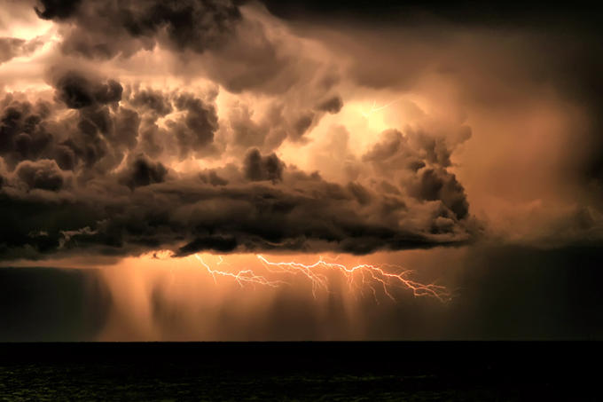
Wild Weather

Slide 2

Rain

Slide 3

By the time raindrops reach the ground, they can be anywhere from one hundred to one thousand times larger than they were inside the cloud.
The biggest raindrops are only about the size of a pencil eraser.
It takes at least one million cloud droplets to form one raindrop.
Only about one cloud in ten will ever part with a single raindrop.

Slide 4
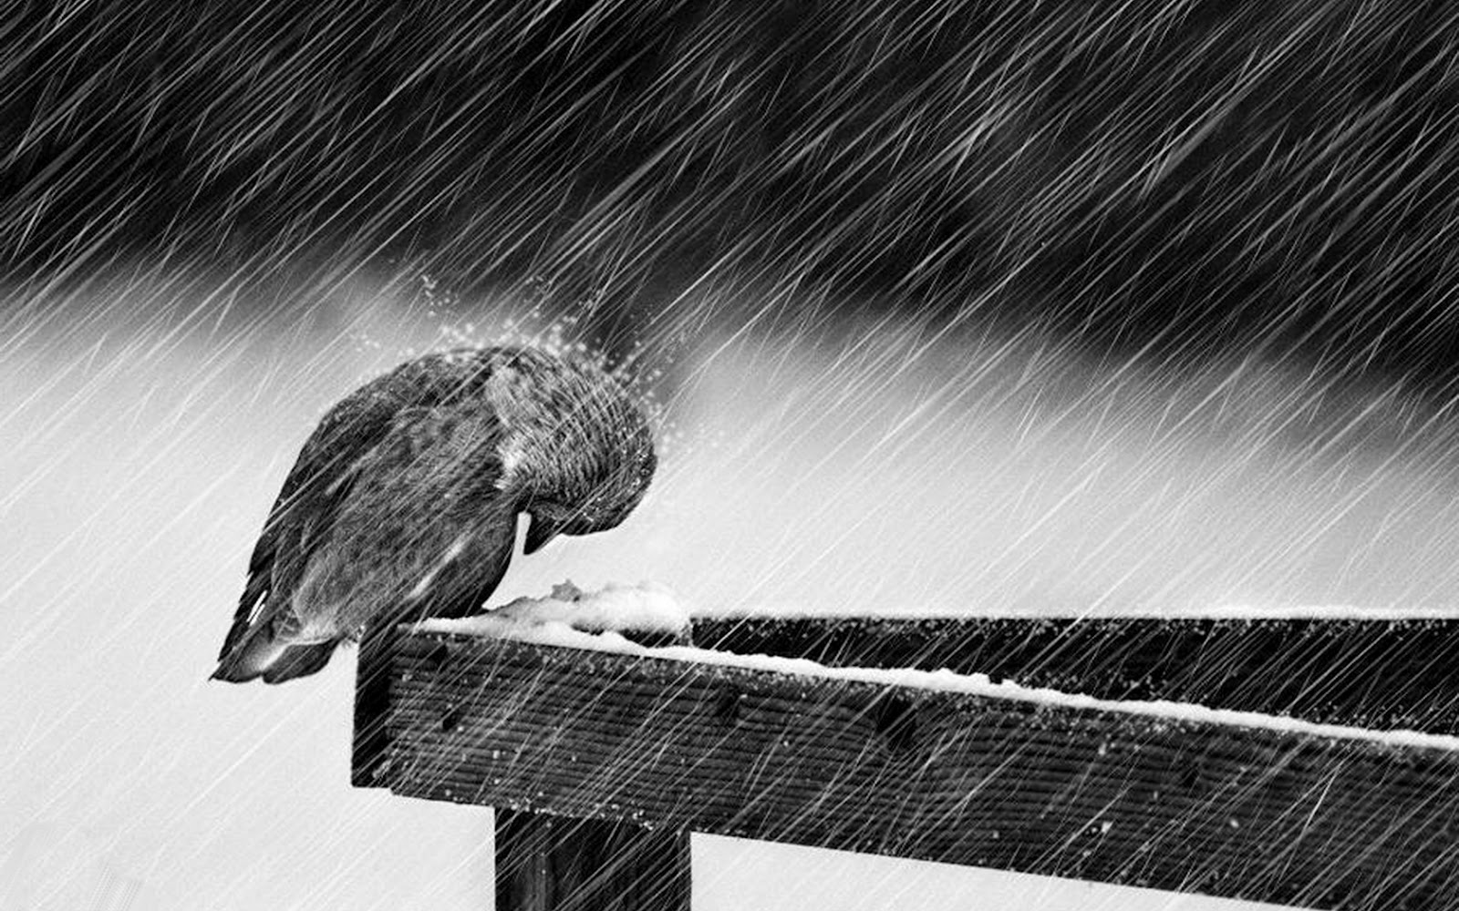

Slide 5
Raindrops are not really shaped like tears. With their rounded tops and flat bottoms, large raindrops actually look like the tops of hamburger buns.
Larger raindrops fall to Earth from 16 to 20 miles per hour.
Tiny drizzle drops can take an hour to fall one mile.
Freezing rain falls as a liquid and then freezes when it touches something cold, such as a tree branch.

Slide 6


Slide 7

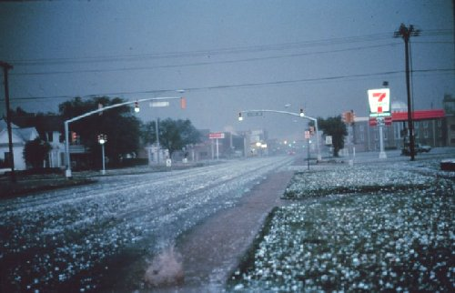
Hail

Slide 8
Hailstones can be smaller than a kernel of corn or bigger than a grapefruit.
In the United States, hail causes $1 billion in crop losses and property damage each year.
The largest hail ever measured was 17.5 inches around and weighed 1.75 pounds.
In Kenya, Africa, on average, it hails 132 days a year.
In Dubuque, Iowa, a hailstone containing two frogs fell to the ground. When the ice melted, the frogs hopped away.

Slide 9
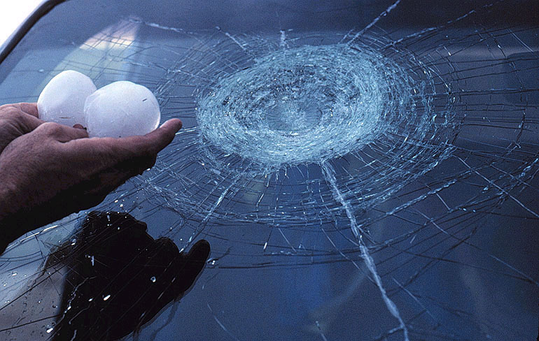

Slide 10
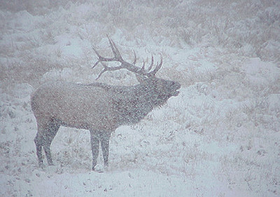
Snow

Slide 11

Each year in the United States, there are about one hundred major snowstorms that last an average of two to five days.
Blue Canyon, California, gets the most snow-about 240 inches each year.
The average snowflake measures about 0.5 inch across.
The largest snowflakes ever measured were 15 inches across.
A blizzard is a heavy snowstorm or blowing snow with winds above 35 miles per hour and lasting at least three hours.

Slide 12
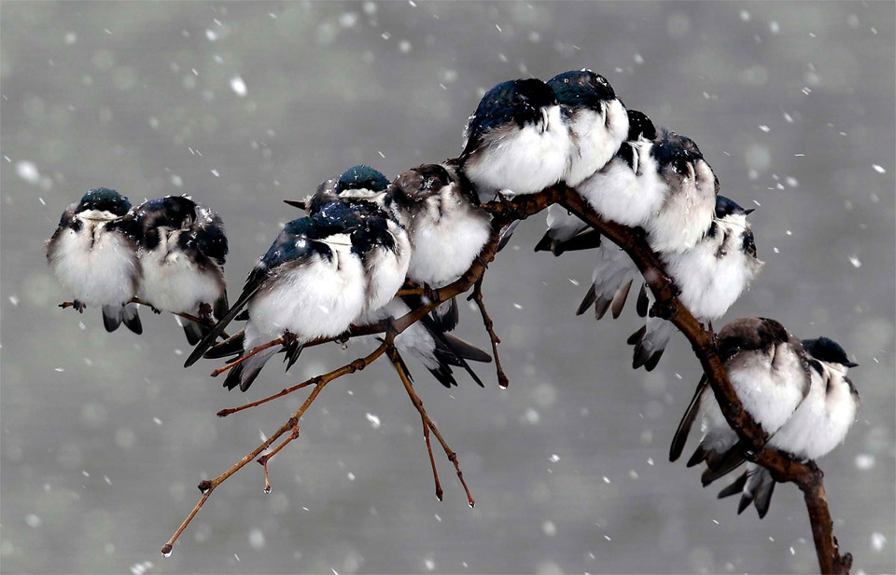

Slide 13

A typical snowflake is made up of 180 billion water molecules.
There are millions of ways these molecules fit together, which is why it is rare to find two snowflakes that are alike, but not impossible.
Since all water molecules have six sides, every snowflake has six sides, no matter how the molecules bond together.

Slide 14
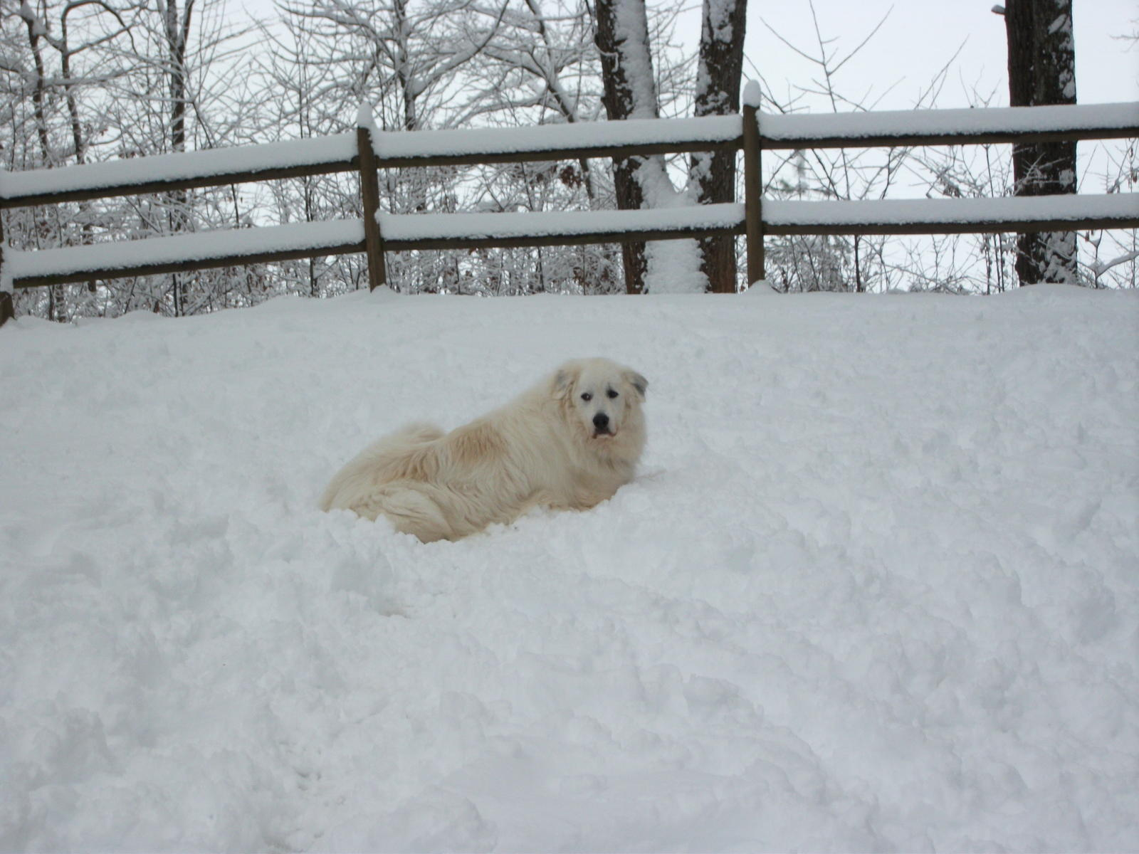

Slide 15
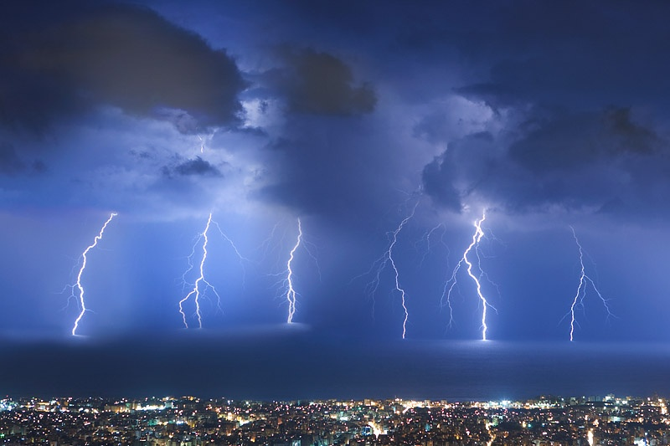
Thunderstorms & Lightning

Slide 16
Right now there are about 2,000 thunderstorms happening on Earth.
About eight million lightning strikes happen every day around the globe.
In very strong winter storms, you sometimes find thunderstorms that make lightning, thunder, and snow.
Most people struck by lightning in the United States are men.
Lightning can be hotter than 50,000 degrees. That’s hotter than the sun!

Slide 17
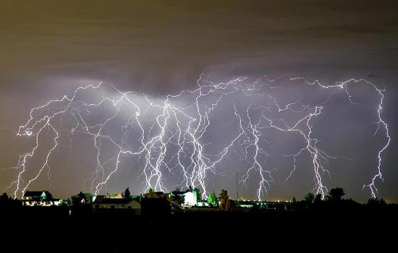

Slide 18
It takes thunder about five seconds to travel one mile.
One lightning flash has enough energy to light a light bulb for three months.
A lightning stroke can travel ten miles from the thunderstorm.
Most people who are struck by lightning are hit before the rain starts or after the rain ends.

Slide 19
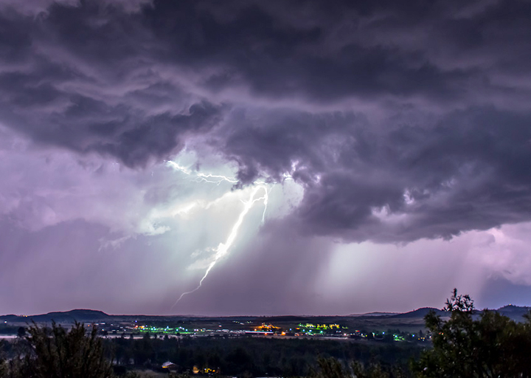

Slide 20
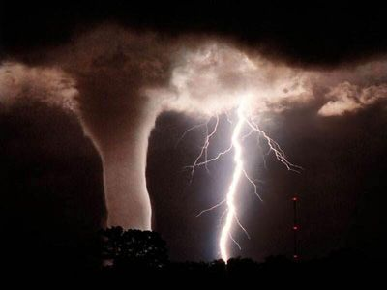

Slide 21
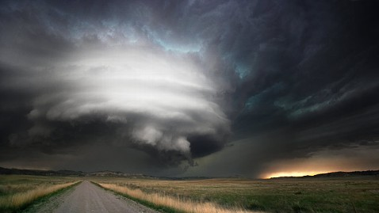

Slide 22
