Slide 1
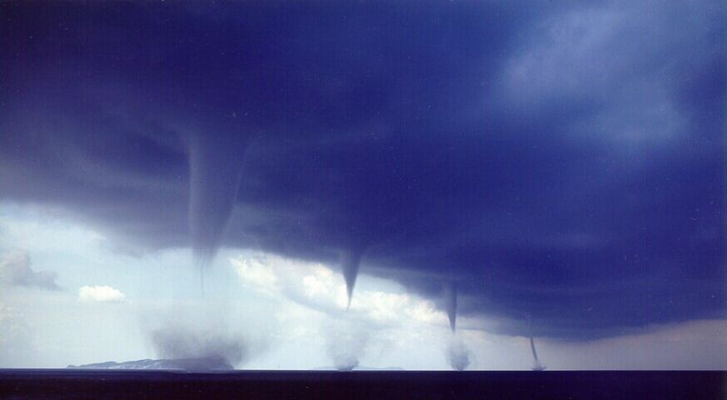
Myths & Facts About Tornadoes

Slide 2
Myth
Tornadoes can happen only in “tornado alley.”
Fact
Tornadoes can happen in every state.
Myth
Tornadoes only happen in the springtime.
Fact
Most tornadoes happen from March through August, but they can happen in any month.

Slide 3
Myth
You should open the windows if a tornado is coming so the building will not be destroyed.
Fact
Research has shown that buildings do not explode from the low air pressure of a tornado. Opening windows can increase the chance of high winds entering and causing more damage to your home and exposing you to injury. Leave the windows alone.

Slide 4
Myth
You should try to “outdrive” a tornado.
Fact
It is not safe to try to outdrive a tornado because tornadoes shift direction so quickly. A tornado can pick up cars and toss them around like toys. If you are in a car during a tornado, get out and find a safe place!

Slide 5
Myth
Highway overpasses are a safe place to hide during a tornado.
Fact
People who take shelter under a highway overpass can be killed because the overpass acts like a wind tunnel and brings stronger winds and a lot of debris.

Slide 6
Myth
Tornadoes never strike big cities.
Fact
Tornadoes do strike big cities. For example, St. Louis has had 22 tornadoes in the past 40 years; Oklahoma City and Salt Lake City have also been struck by tornadoes.

Slide 7
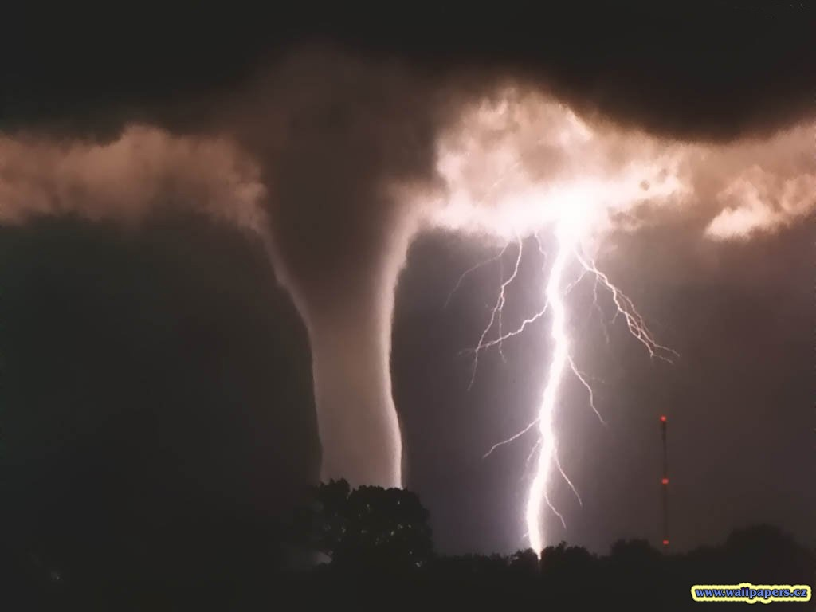
Tornado Facts

Slide 8
About 1,000 tornadoes happen every year in the United States.
Mobile homes don’t attract tornadoes, but they are more damaged by them than regular homes are.
There might be such a thing as an EF-6 tornado. Meteorologists think it can happen, but no one has measured one that strong yet.

Slide 9
While most tornadoes don’t hurt people, in 1925 an F-5 tornado killed nearly 700 people. It last more than three hours as it moved 219 miles across three states (Missouri, Illinois, and Indiana).
Big tornadoes are not always stronger than smaller ones.
Not all tornadoes make loud roaring noises. Some are very quiet.

Slide 10
Tornadoes can cross rivers and valleys.
A few tornadoes spin in the opposite direction. Meteorologists don’t know why.
“Tornado alley” includes all or part of Texas, Oklahoma, Kansas, Nebraska, and South Dakota. New studies show that “tornado alley” should be expanded.
About ¾ of the world’s tornadoes happen in the United States.

