Slide 1
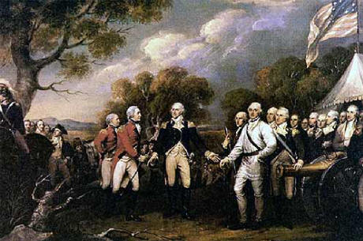
Important People of the American Revolution

Slide 2
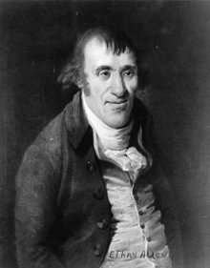
Ethan Allen
Allen led the Green Mountain Boys in the capture of Fort Ticonderoga in May 1775.

Slide 3
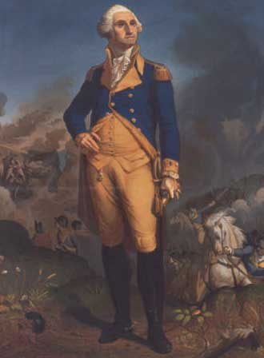
George Washington
Washington was Commander-in-Chief of the Continental Army during the American Revolution.

Slide 4
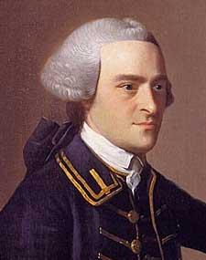
John Hancock
Hancock served as President of the Second Continental Congress and was the first to sign the Declaration of Independence.

Slide 5
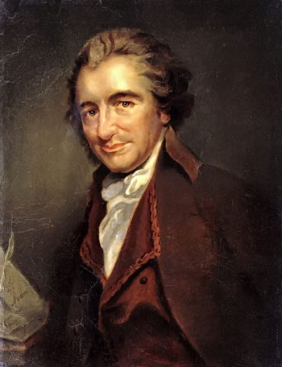
Thomas Paine
Paine was the author of Common Sense, which convinced many people it was time to declare independence.

Slide 6
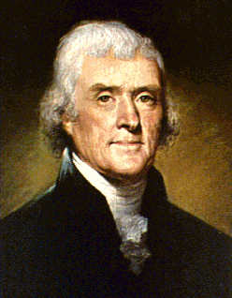
Thomas Jefferson
Jefferson was a member of the Continental Congress and the author of the Declaration of Independence.

Slide 7
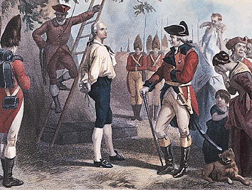
Nathan Hale
Hale was a Patriot who was hanged as a spy by the British in 1776.

Slide 8
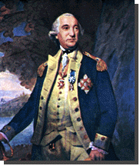
Friedrich Von Steuben
Friedrich Von Steuben was a military officer from Germany who trained the American soldiers at Valley Forge.

Slide 9
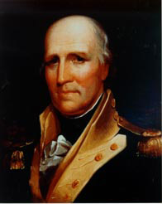
George Rogers Clark
Clark led a small Patriot force that captured Fort Vincennes in the Ohio River Valley in 1779.

Slide 10
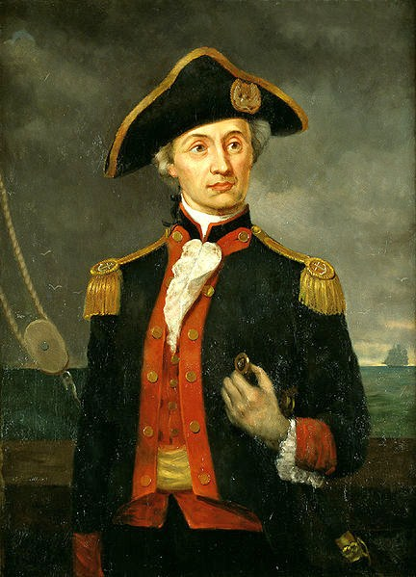
John Paul Jones
Jones commanded the American ship Bonhomme Richard, which defeated the British ship Serapis in 1779.

Slide 11
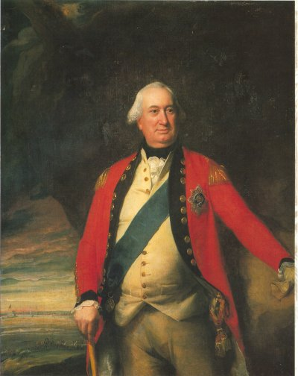
Charles Cornwallis
Lord Cornwallis was the general of the British forces that were defeated at Yorktown in 1781, ending the American Revolution.

