Slide 1
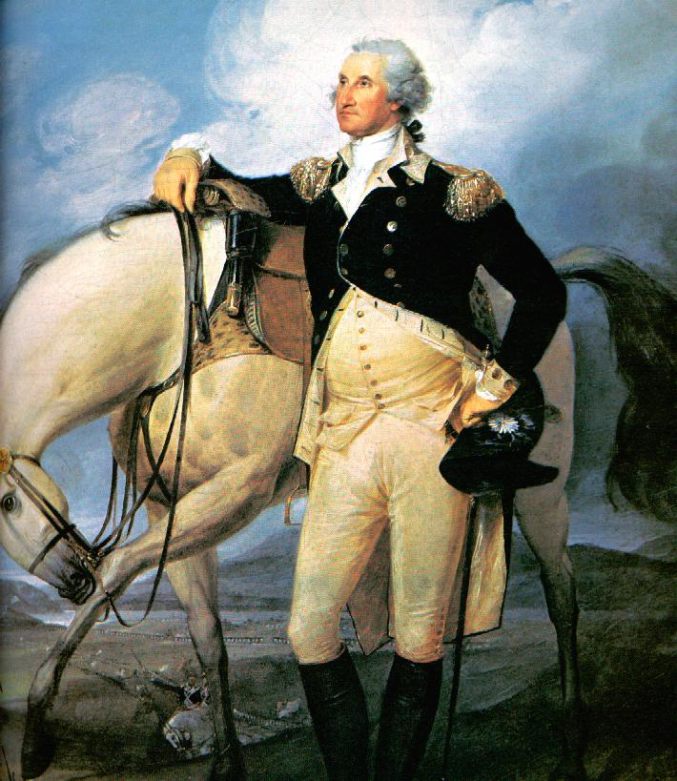
Important People on the Road to Revolution

Slide 2
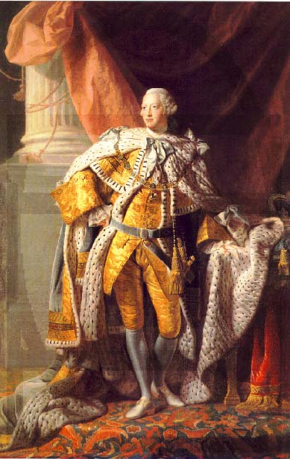
King George III
He was the king of Great Britain, and supported the idea of taxing the colonists.

Slide 3
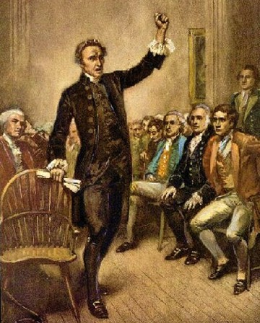
Patrick Henry
He was one of the first to speak out against the Stamp Act, and inspired others to protest.

Slide 4
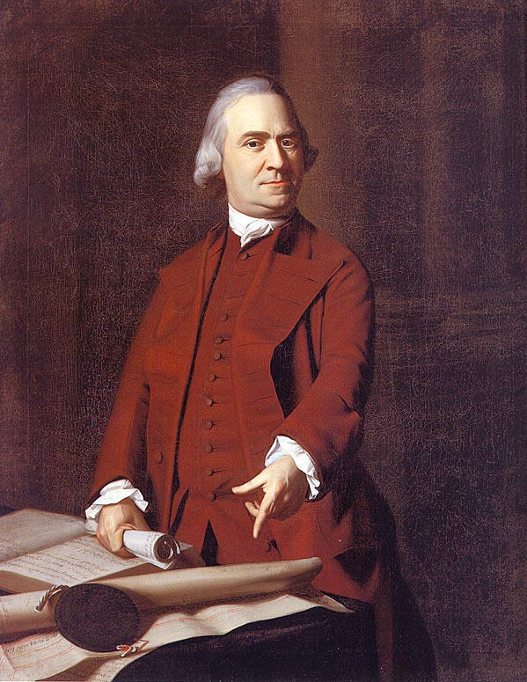
Samuel Adams
Adams inspired people to take action. He formed the Sons of Liberty and Committees of Correspondence.

Slide 5
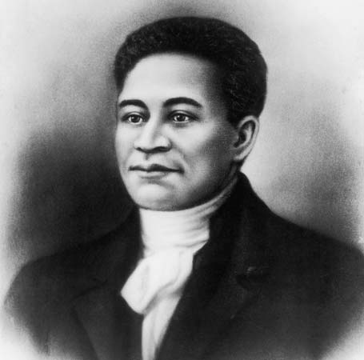
Crispus Attucks
Attucks was an escaped slave who died in the Boston Massacre in 1770.

Slide 6
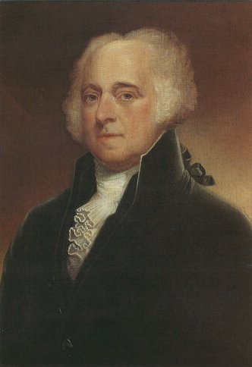
John Adams
Adams defended the soldiers from the Boston Massacre, and opposed British taxes.

Slide 7
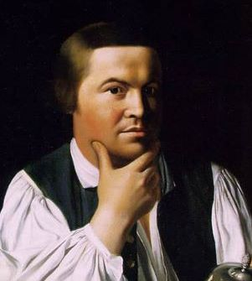
Paul Revere
Revere was an “express rider” for the Committee of Correspondence, and later warned the colonists of the British advance at the start of the war.

Slide 8
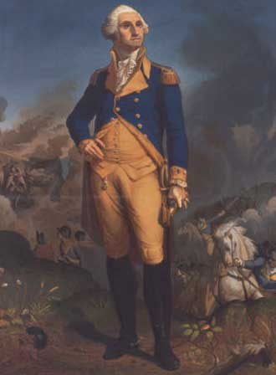
George Washington
Washington was a member of the VA House of Burgesses; represented VA at the 1st Continental Congress.

