Slide 1
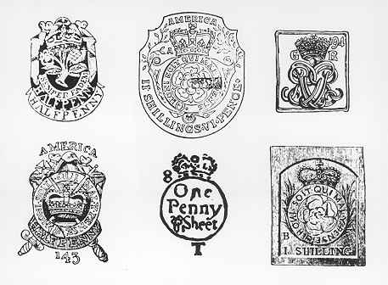
Stamp Act Stamps

Slide 2
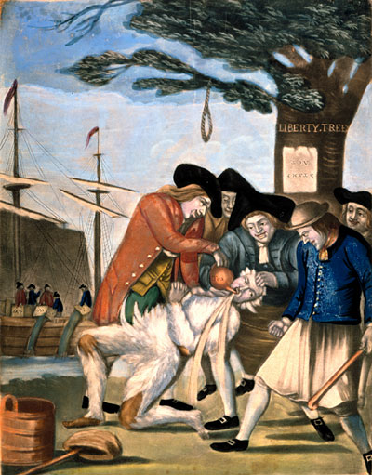
Bostonians Paying the Excise Man

Slide 3
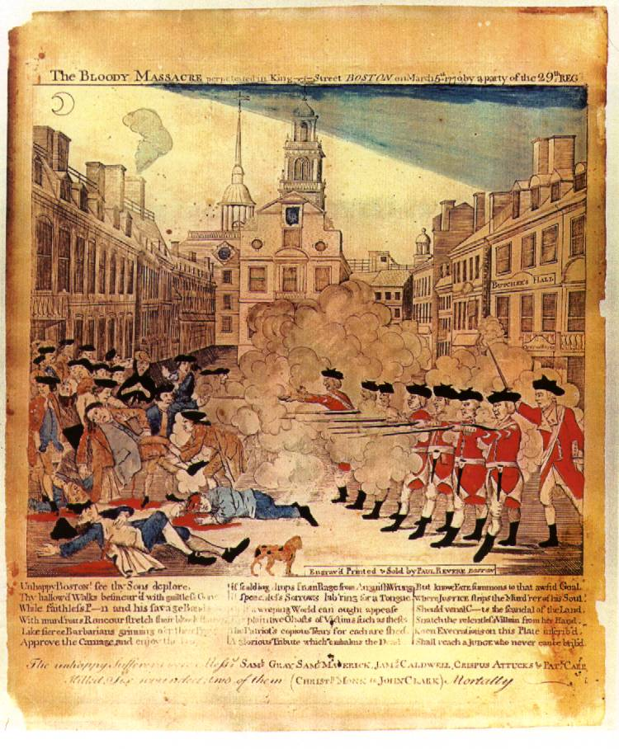

Slide 4
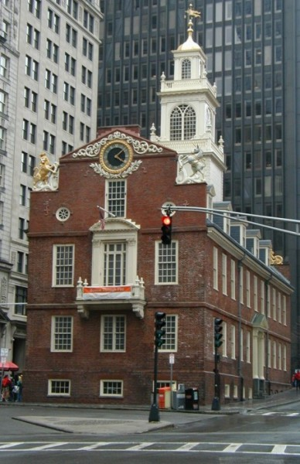
Site of the Boston Massacre

Slide 7
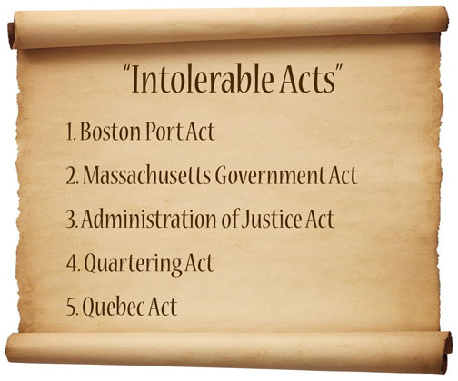

Slide 8
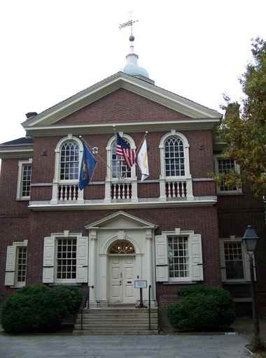
Carpenters’ Hall, site of the First Continental Congress

Slide 10
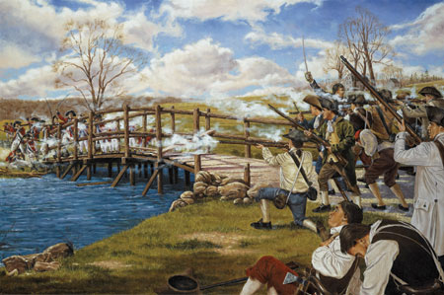
Battle at the Old North Bridge in Concord, MA

Slide 11
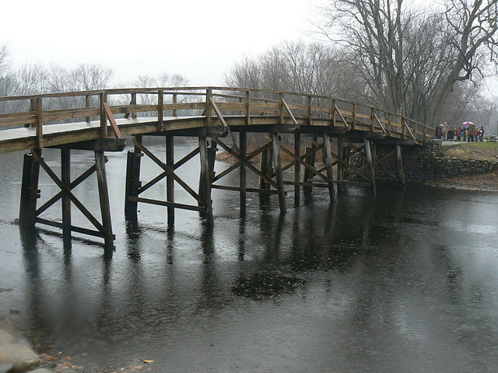
Old North Bridge in Concord, MA

