Slide 1
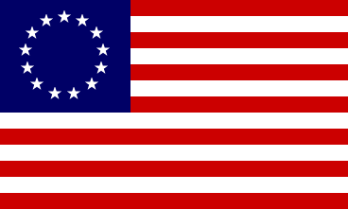
Flags of the American Revolution

Slide 2
Sons of Liberty
This flag represented the group formed by Samuel Adams to protest the Stamp Act. It was also known as the “Rebellious Stripes.”

Slide 3
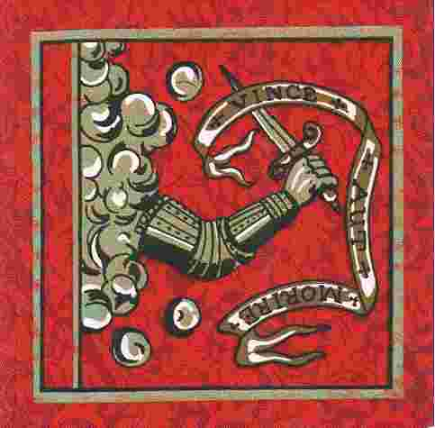
Bedford Flag
This flag was present at the Battle of Concord. The Latin inscription “Vince Aut Marire” means “Conquer or Die.” The original can be seen at the Bedford Town Library.

Slide 4
Green Mountain Boys
This flag was carried by the men under the command of Ethan Allen. Its green field represented their name, and the thirteen stars was a tribute to the thirteen colonies.

Slide 5
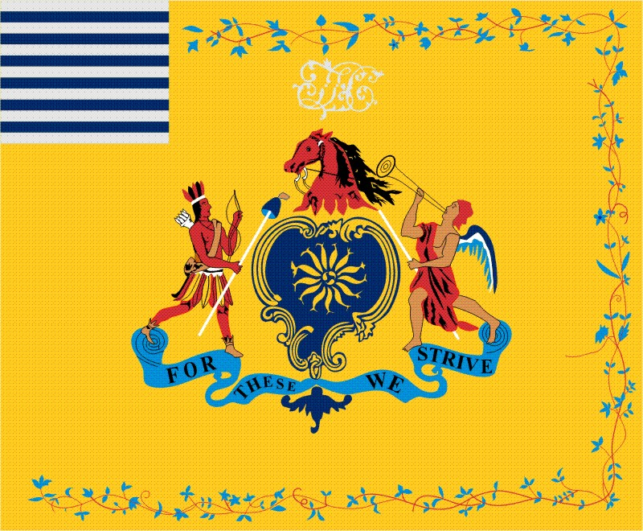
Philadelphia Light Horse Troop
This troop escorted General Washington from Philadelphia to take command of the Continental Army in Cambridge, MA. They later carried this flag in the Battles of Brandywine, Germantown, Princeton, and Trenton.

Slide 6
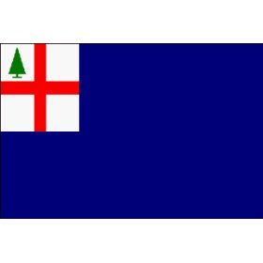
Bunker Hill
When the British advanced up Breed’s Hill they saw this early New England flag. The colonists still saw themselves as British subjects but were declaring their right to be free from violations of their freedoms.

Slide 7
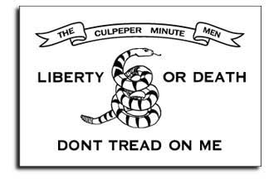
Culpeper, VA
This flag represented a group that formed part of Colonel Patrick Henry’s First Virginia Regiment of 1775. In October 1775, 300 minutemen assembled at Culpeper Court House and marched to Williamsburg.

Slide 8
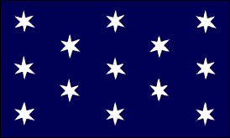
Washington’s Headquarters
This flag was flown at the headquarters of General Washington during most of the American Revolution.

Slide 9
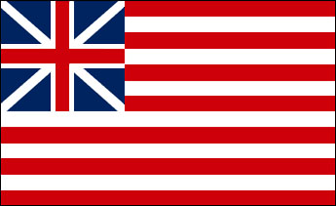
Grand Union
This is considered to be the first flag of the United States, used from late 1775 until mid 1777. In the canton was the flag of Great Britain, indicating continued loyalty, and the thirteen stripes represented the thirteen colonies.

Slide 10
Washington Cruisers
This was used by Washington on his squadron of six schooners which he outfitted at his own expense in the fall of 1775. It was later modified and used by the Massachusetts Navy.

Slide 11
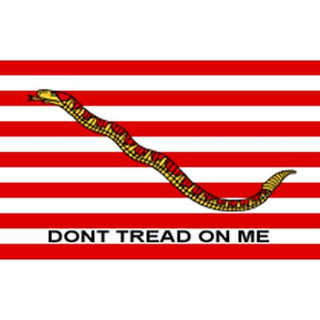
Continental Navy Jack
This flag may have flown aboard the Continental Fleet’s flagship, Alfred, in January 1776. Some people believe that they used a red and white striped flag, like the flag of the Sons of Liberty. There isn’t any real evidence either way.

Slide 12
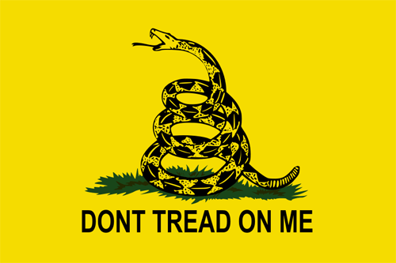
Gadsden Flag
This was first used in 1776 by the commander of the New Continental Fleet, Commodore Esek Hopkins. The designer, Colonel Christopher Gadsden of S.C., then presented it to the Continental Congress.

Slide 13
Fort Moultrie
This flag was carried by Colonel Moultrie’s South Carolina Militia when the British were defeated in Charleston in June 1776. This saved the south from British occupation for another two years.

Slide 14
Betsy Ross Flag
This flag was adopted on June 14, 1777 (Flag Day). “That the flag of the United States be thirteen stripes, alternate red and white; that the union be thirteen stars, white in a blue field, representing a new constellation.”

Slide 15
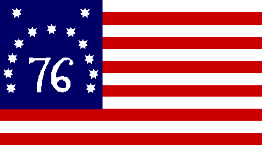
Bennington Flag
On August 16, 1777, the American militia defeated a large British raiding force and saved the military supplies in Bennington, Vermont.

Slide 16
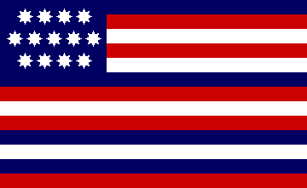
Serapis Flag
In September 1779, this flag was flown over the Bonhomme Richard during its epic battle in the North Sea with the British frigate Serapis.

Slide 17
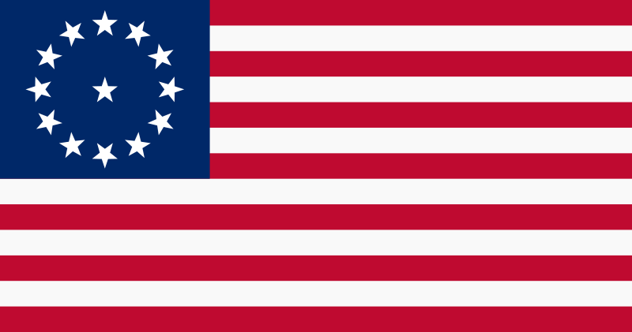
Cowpens Flag
This was first carried by the Third Maryland Regiment. They helped General Daniel Morgan win a decisive victory over the British at Cowpens, S.C., on January 17, 1781.

Slide 18
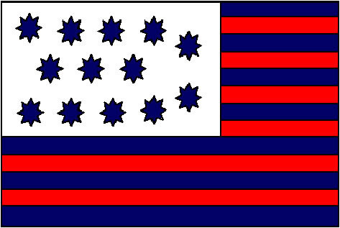
Guilford Courthouse
This flag was raised over Guilford Courthouse, N.C., on March 15, 1781. The Americans stopped the British advance through the Carolinas in one of the bloodiest battles of the war.

Slide 19
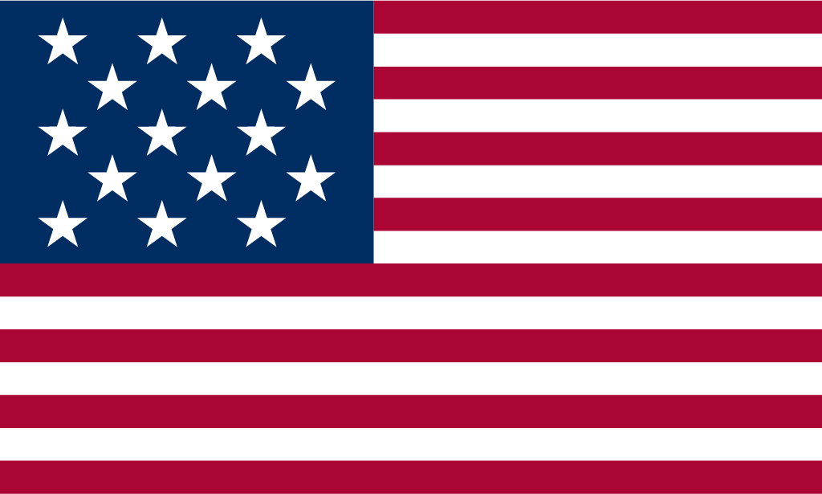
Star Spangled Banner
This was the official flag of the United States from the early 1790s, when Vermont and Kentucky were added to the Union, until 1818.

