Slide 1
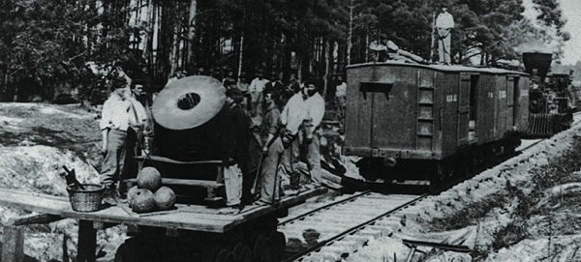
Civil War Technology

Slide 2
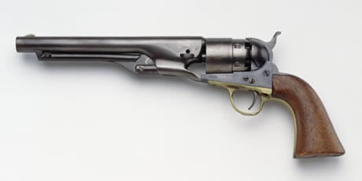
Colt .32 Caliber Revolver

Slide 3
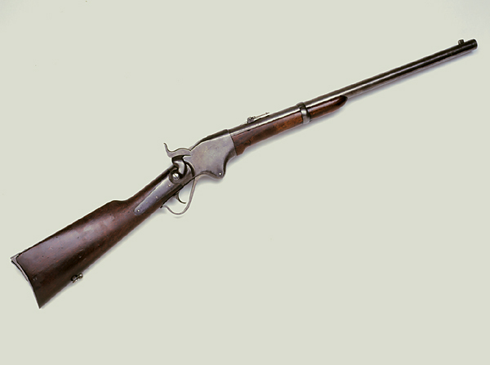
Spencer Repeating Carbine .56 Caliber Rifle

Slide 4
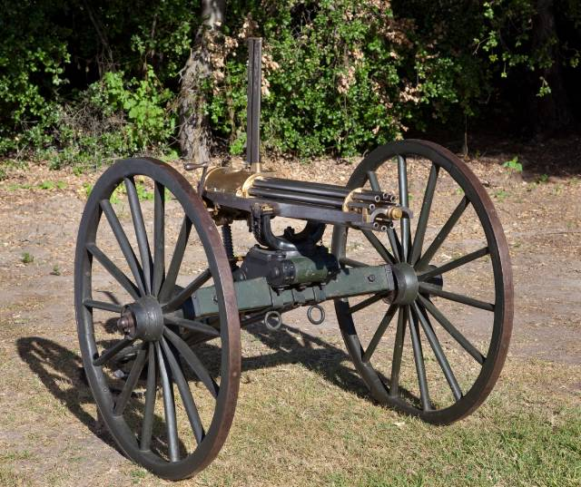
Gatling Gun .58 Caliber
300 rounds per minute

Slide 5
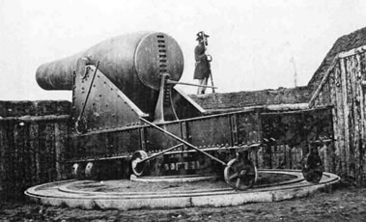
15-inch Rodman smoothbore, one of the largest guns mounted during the war

Slide 6
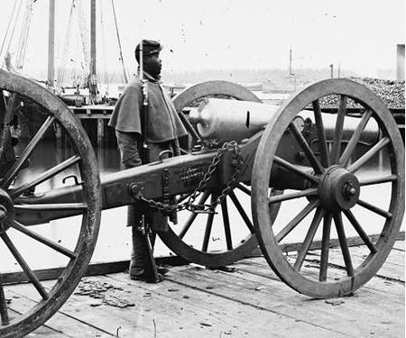
12-Pounder Napoleon

Slide 7
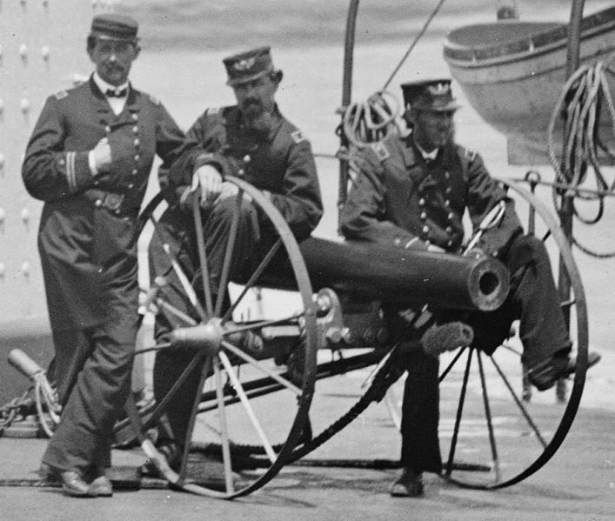
12-pound Howitzer

Slide 8
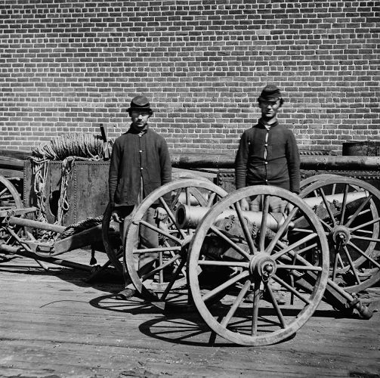
Small Howitzer

Slide 9
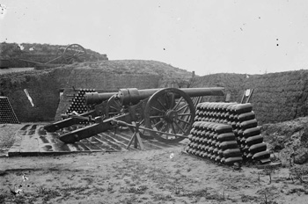
30-Pounder Parrott Rifles

Slide 10
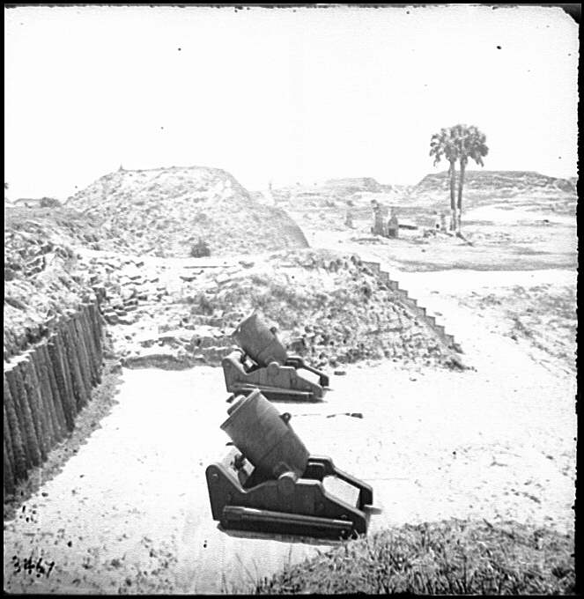
8-inch mortars were light enough to be transported by an army on the march, and were used in sieges and to defend fortifications.

Slide 11
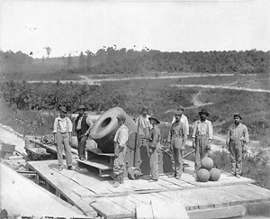
The “Dictator,” a 13 inch mortar
Projectile weight: 200 pounds
Range: About 2 ½ miles

Slide 12
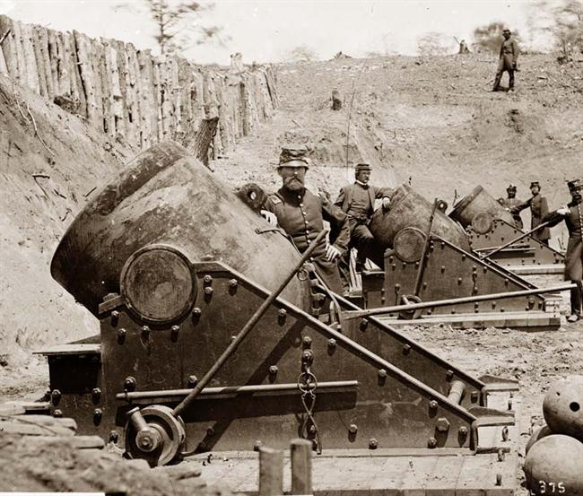
These were usually used to defend rivers and coastal waterways.

Slide 13
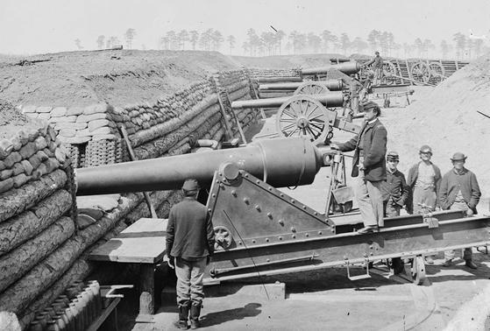
100-pounder Parrott rifle
Range: 5 miles

Slide 14
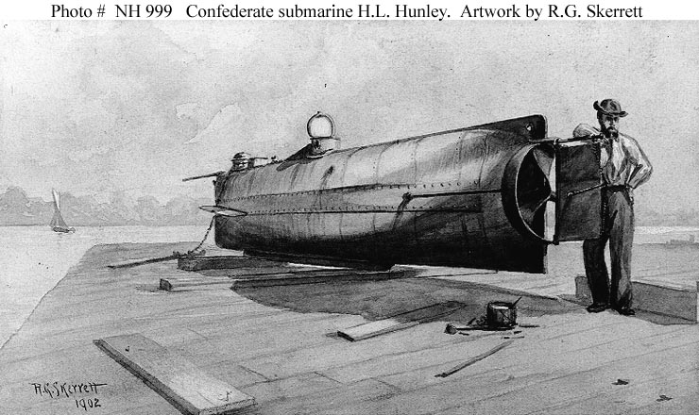
The C.S.S. Hunley was hand-propelled by a crew of eight, and was 25 feet long.

Slide 15
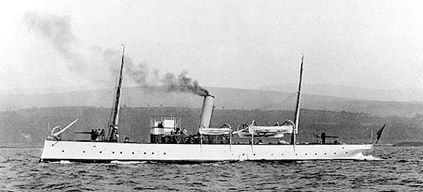
Steam-powered gunboats were used to enforce the blockade against the South.

Slide 16
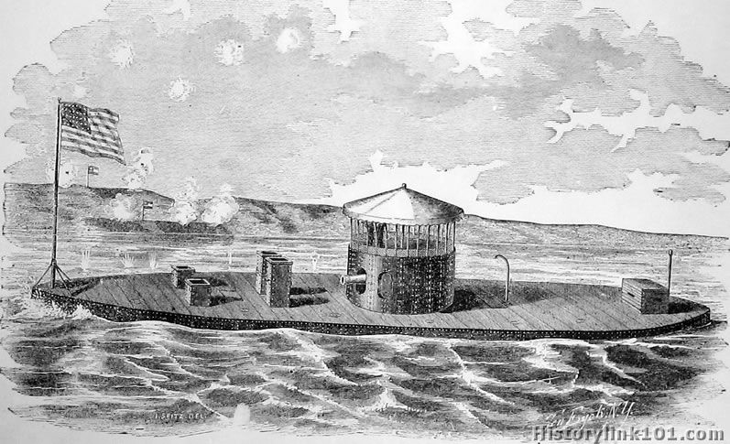
U.S.S. Monitor

Slide 17
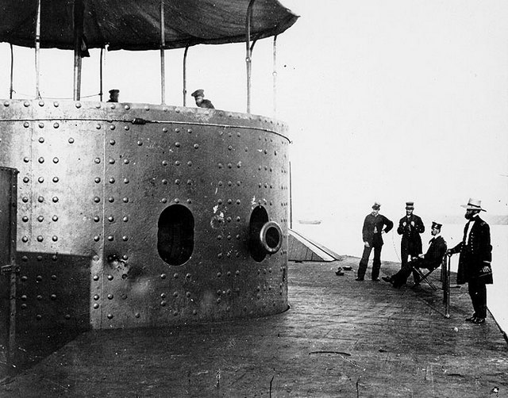
Main deck of the U.S.S. Monitor

Slide 18
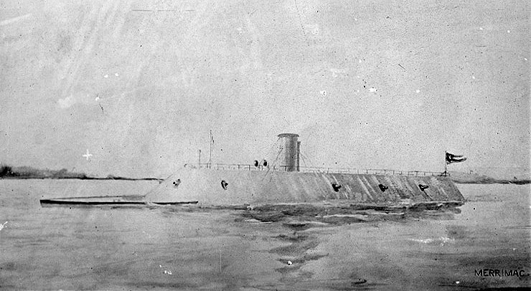
Merrimac, or C.S.S. Virginia

Slide 19
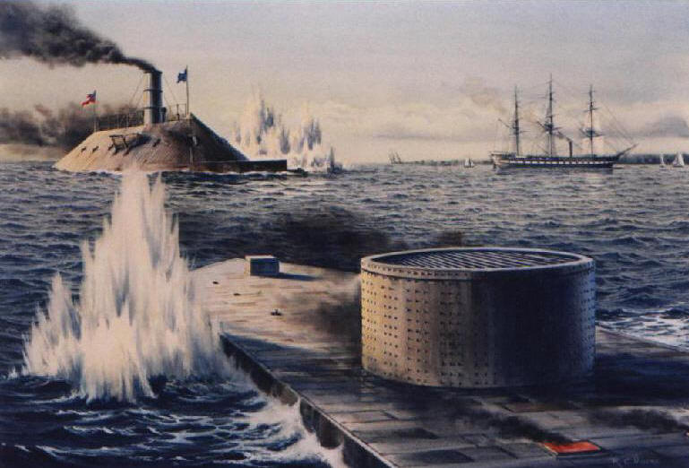

Slide 20
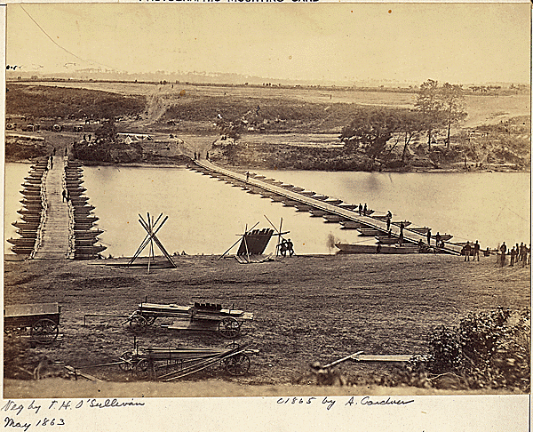
Portable Pontoon Bridges

Slide 21
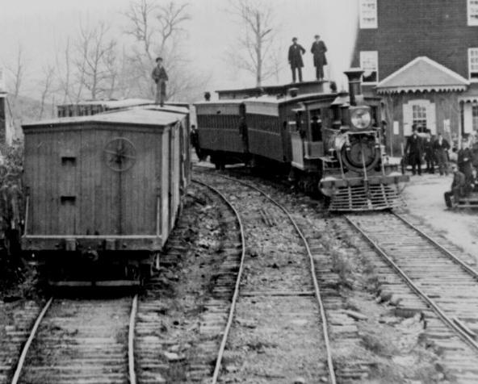
Over 5 million tons of supplies were delivered each year to the armies in the field on the Federal Military Railroad.

Slide 22
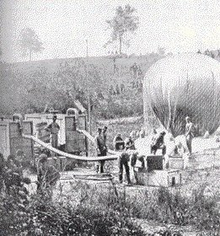
Hot air balloons were used to spy on the enemy.

Slide 23
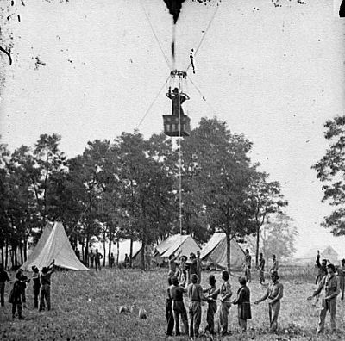

Slide 24
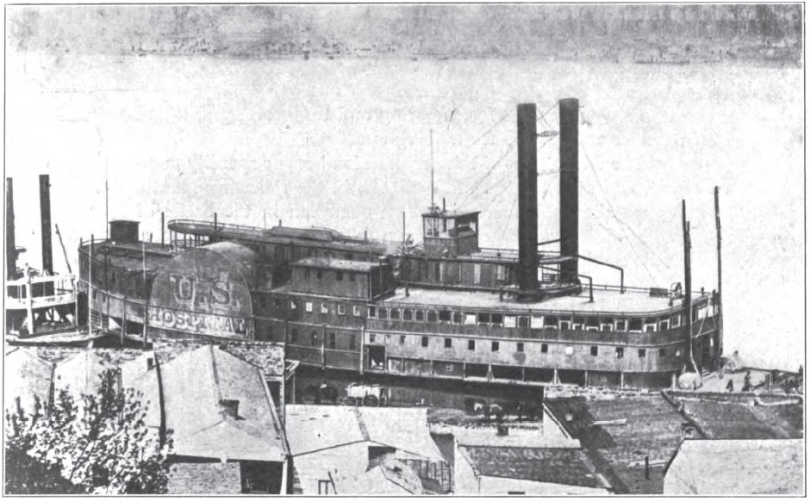
U.S. Hospital Ship “Red Rover”

Slide 25
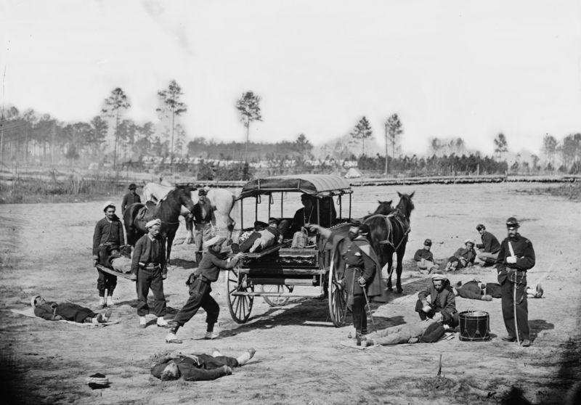
A Civil War Ambulance

