Slide 1
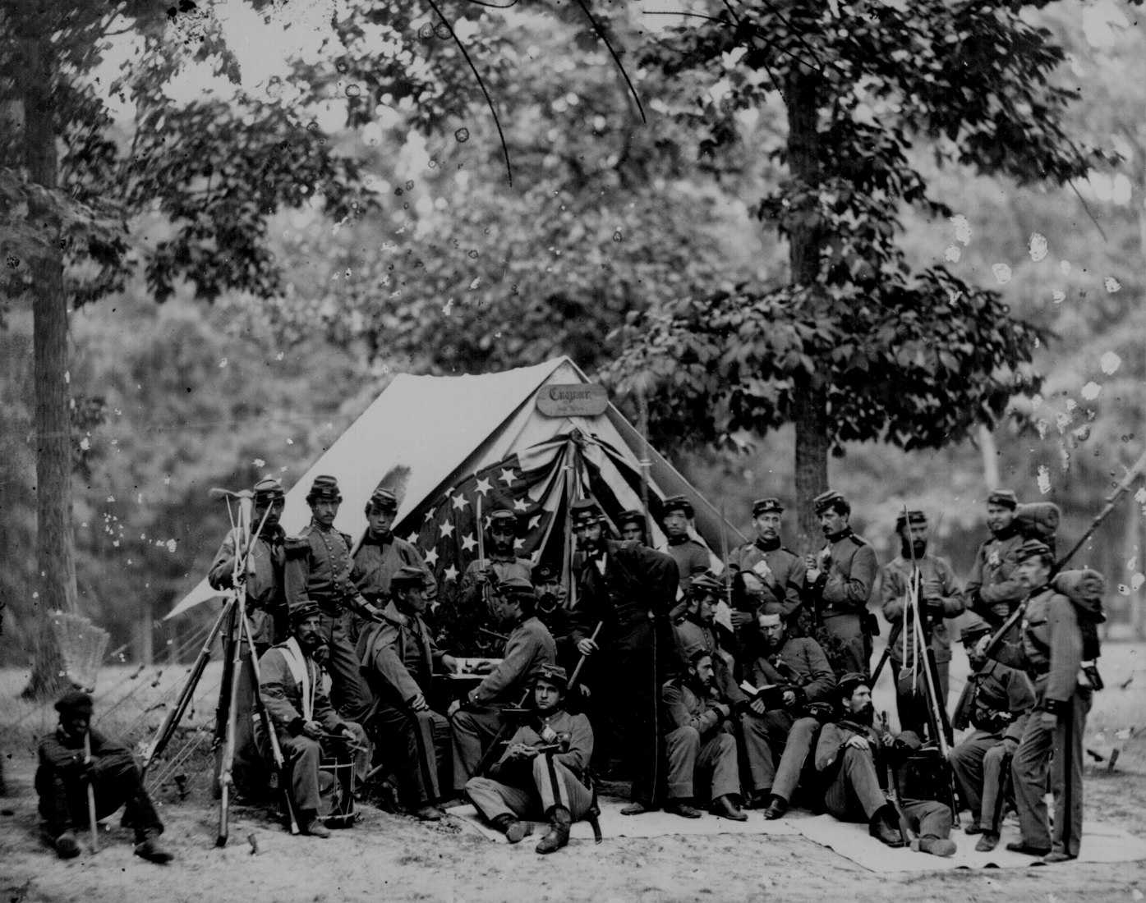
Images of the Civil War

Slide 2
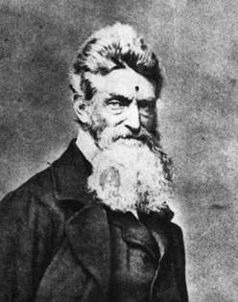
John
Brown

Slide 3
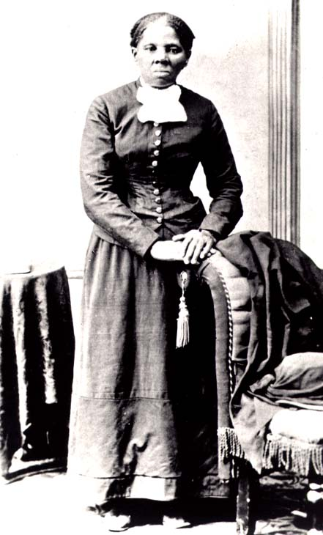
Harriet
Tubman

Slide 4
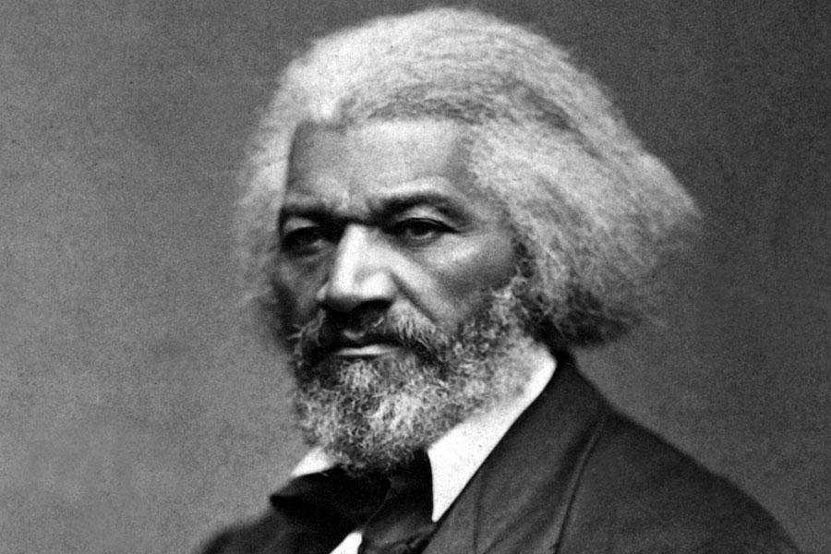
Frederick
Douglass

Slide 5
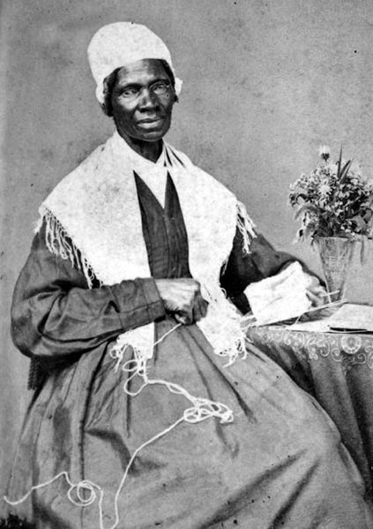
Sojourner
Truth

Slide 6
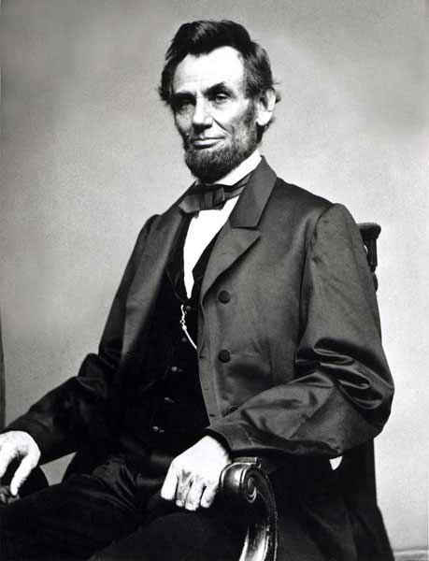
President
Abraham
Lincoln

Slide 7
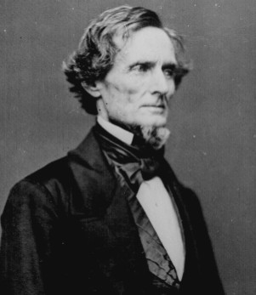
Confederate
President
Jefferson
Davis

Slide 8
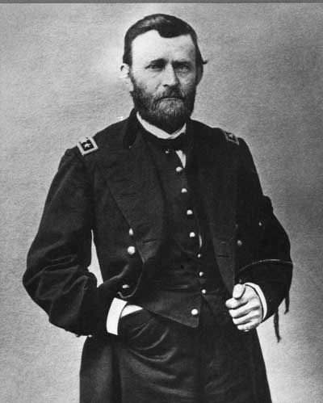
Lieutenant
General
Ulysses S. Grant

Slide 9
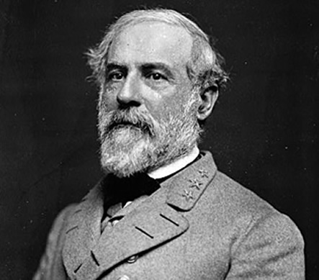
CSA General
Robert E. Lee

Slide 10
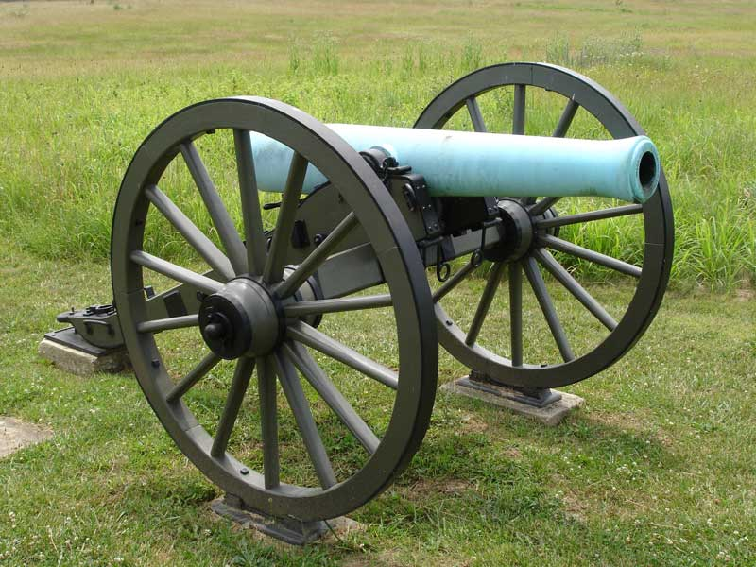
Model 1857 “Napoleon” Howitzer

Slide 11
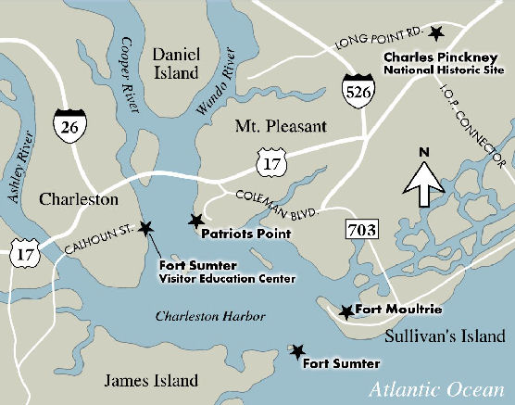

Slide 12
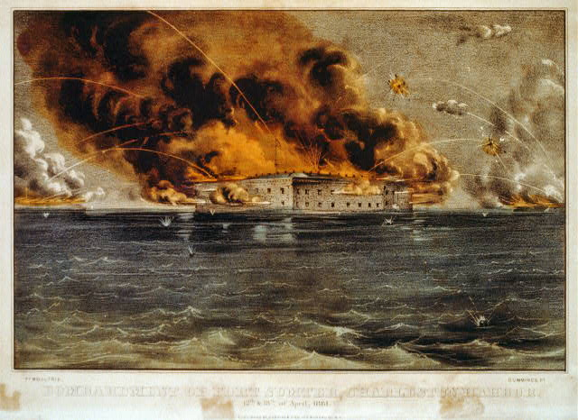

Slide 13
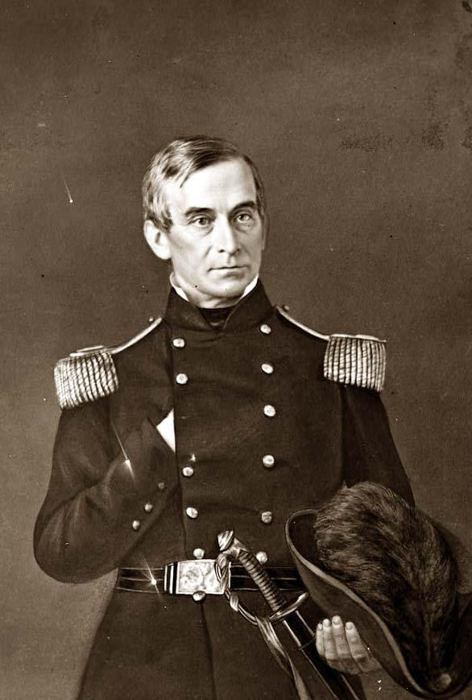
U.S. Major
Robert
Anderson

Slide 14
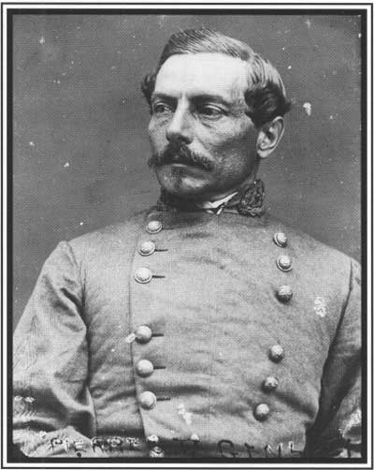
CSA Brig. Gen.
P.G.T.
Beauregard

Slide 15
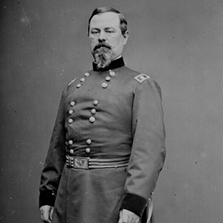
Union General
Irvin
McDowell

Slide 16
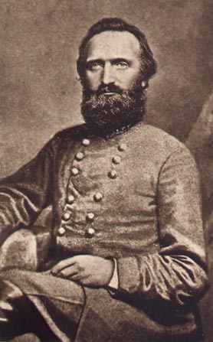
Confederate
Lt. General
Thomas J.
“Stonewall”
Jackson

Slide 17
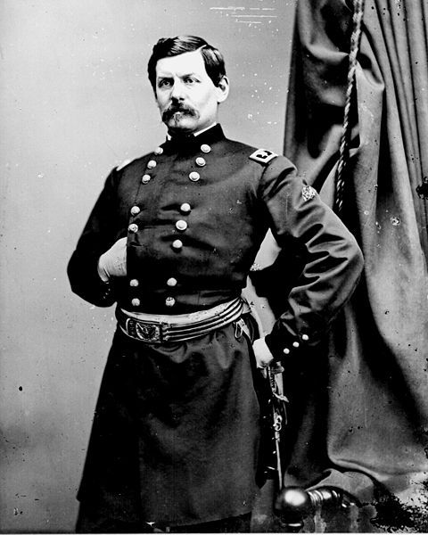
Union
General
George
McClellan

Slide 18
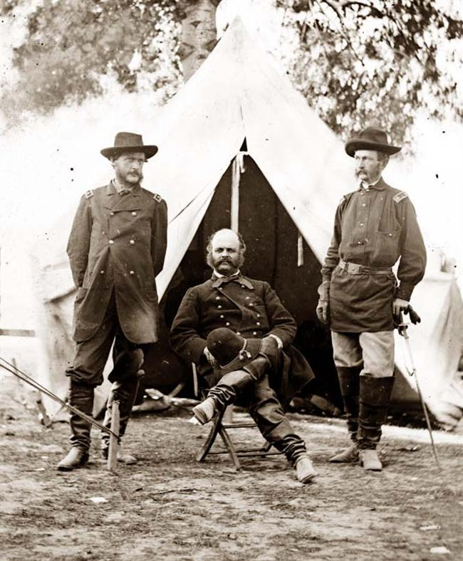
Union Gen.
Ambrose
Burnside

Slide 19
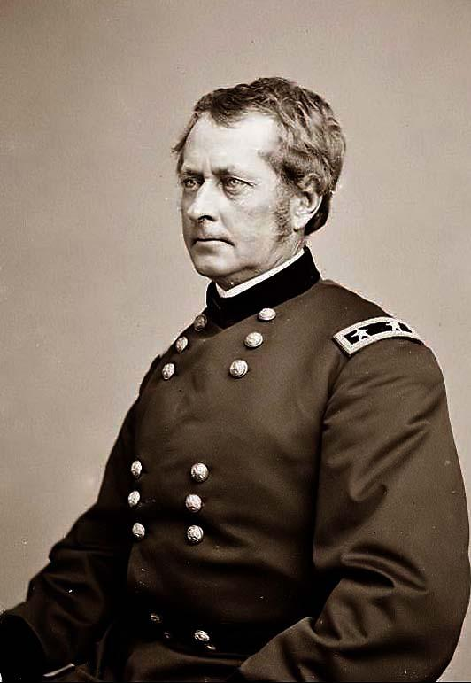
Union
General
Joseph
Hooker

Slide 20
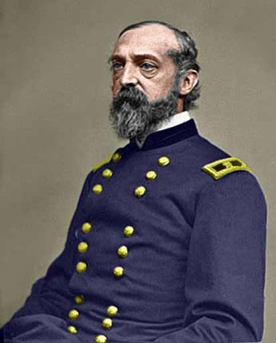
Union
General
George
Meade

Slide 21
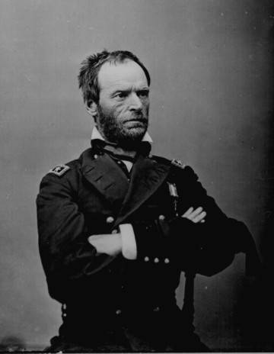
Union General
William
Tecumseh
Sherman

Slide 22
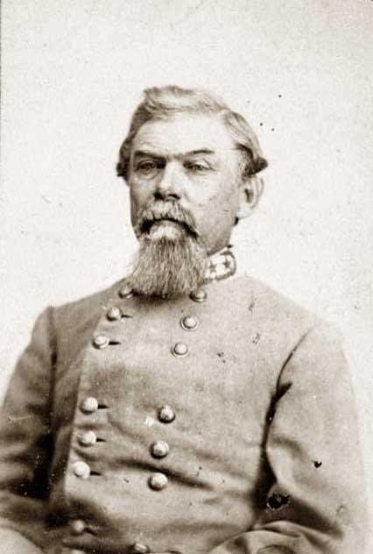
Confederate
Lieutenant General
William J.
Hardee

Slide 23
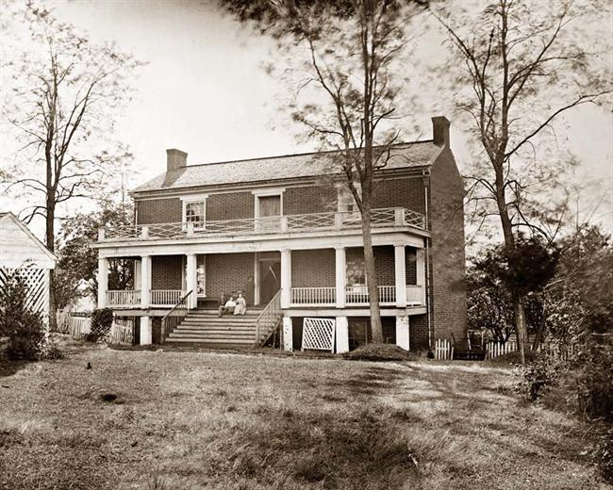
McLean House: Appomattox Court House, VA

Slide 24
