Slide 13
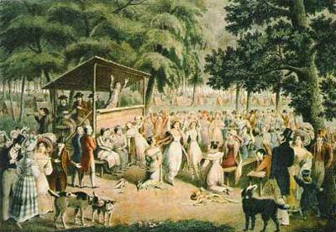
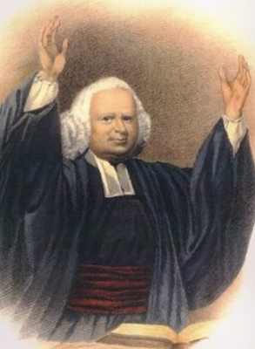
Religion in the Colonies
George Whitefield
Great Awakening – religious revival that helped foster a sense of independence from Great Britain

Slide 14
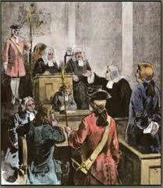
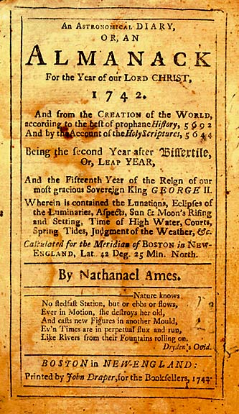
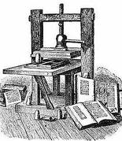
Reading
Important means of sharing news and entertainment
Trial of John Peter Zenger assured
“Freedom of the Press”

