Slide 1
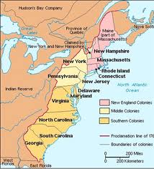
The 13 English Colonies

Slide 2
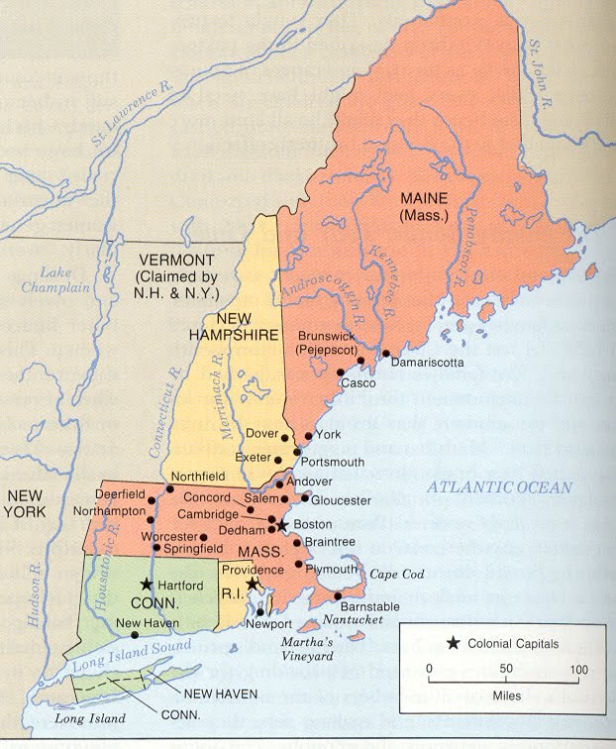
New England
Massachusetts Bay (1630)
Connecticut (1636)
Rhode Island (1636)
New Hampshire (1679)

Slide 3
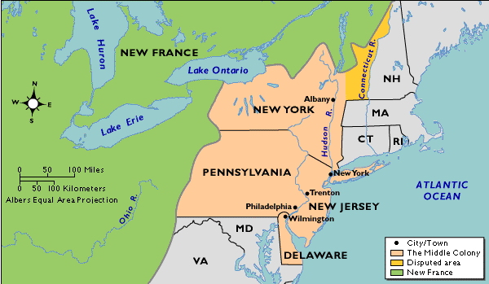
Middle
New York (1664)
New Jersey (1664)
Pennsylvania (1682)
Delaware (1704)

Slide 4
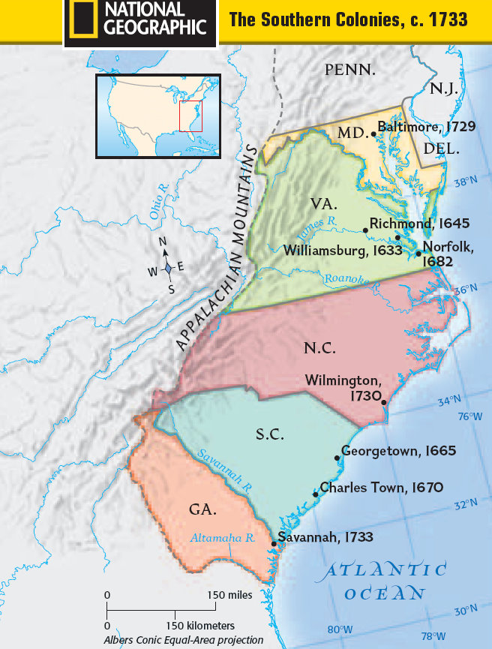
Southern
Virginia (1607)
Maryland (1634)
North Carolina (1729)
South Carolina (1729)
Georgia (1733)

